Slide 1
CUDA at Scale for the Enterprise
Multiple CPU Architectures

Slide 2
CPU to CPU Comms
Typical mechanisms for multiple CPU communication (note that can be multiple cores on the same machine):
File system (local or networked)
Sockets
Message queueing system
RPC/REST

Slide 3
Points to Consider
Async vs sync
Coherency
Batch vs Streaming
Network and connection resilience
Security, Access, Roles

Slide 4
Multiple CPU Patterns
Star/Centralized
Mesh/Decentralized
Ring

Slide 5
How Does this Apply with a Shared Resource?
Need to localize management software to CPU(s) able to communicate with GPU.
How important is getting fast vs complete answers?
Is CPU connectivity guaranteed or at least reliable?
Are you trying to apply to a lot of data at once or continuously with smaller data?

Slide 7

















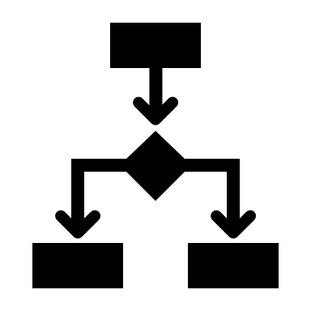
































EDUCATION ICONS
ENGINEERING ICONS

